Slide 1
数 据 库 原 理
Chp 16
Query Optimization
王 建 民
清 华 大 学 软 件 学 院
2023年/春

Slide 2
本节课的内容
理论 | 核心知识点 | 对应章节
数据库理论 | 关系模型、关系代数、关系演算 | CHP. 1、2
数据库应用 | SQL语言、JDBC | CHP 3、4、5
数据库设计 | 实体-联系图、关系范式 | CHP 6、7
数据库实现 | 存贮、索引、查询、优化、 事务、并发、恢复 | CHP 12、13、14、15、 16、17、18、19

Slide 3
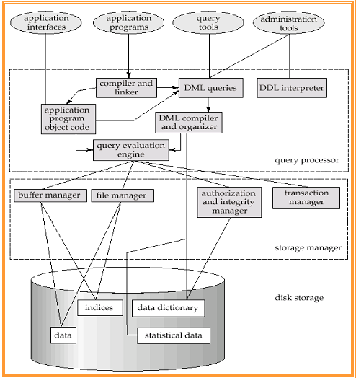
DBMS Architecture
optimizer

Slide 4

查询处理的三个步骤
1. Parsing and translation
2. Optimization
3. Evaluation
/evaluation plan

Slide 5
Contents
Introduction（16.1）
Transformation of Relational Expressions（16.2）
Estimating Statistics of Expression Results（16.3）
Choice of Evaluation Plans（16.4.1-16.4.3）
Page 743 - 774

Slide 6
关系代数操作（共13个）
No | Basic | No | Additional | No | Extended
1 | Union | 7 | Set intersection | 11 | Generalized Projection
2 | set difference | 8 | Natural join | 12 | Aggregate Functions
3 | Cartesian product | 9 | Division | 13 | Outer Join
4 | Select | 10 | Assignment
5 | Project
6 | Rename

Slide 7
关系代数表达式（E1，E2)
  （并）E₁ ∪ E₂
  （差） E₁ - E₂
  （笛卡尔积）E₁ x E₂
  （选择）σ_{p} (E₁), P is a predicate on attributes in E₁
  （投影） ∏_{s}(E₁), S is a list of the attributes in E₁
  （换名） ρ _{x} (E₁), x is the new name for the result of E₁
  （交） E₁ ∩ E₂
  （自然连接）E₁ ►◄ E₂
  （除法） E₁ ÷ E₂
  （赋值）r ← E₁
  （泛化投影） ∏_{f(a)} (E₁),
  （聚合函数） _{A1}𝛾_{af，}af is the aggregation function
  （外连接）E₁ =►◄= E

Slide 8

SQL查询的多种策略
Alternative ways of evaluating a given query
  Equivalent expressions
  Different algorithms for each operation
    E.g. 15.3 Selection operations (A1, A2, …, A10)

Slide 9
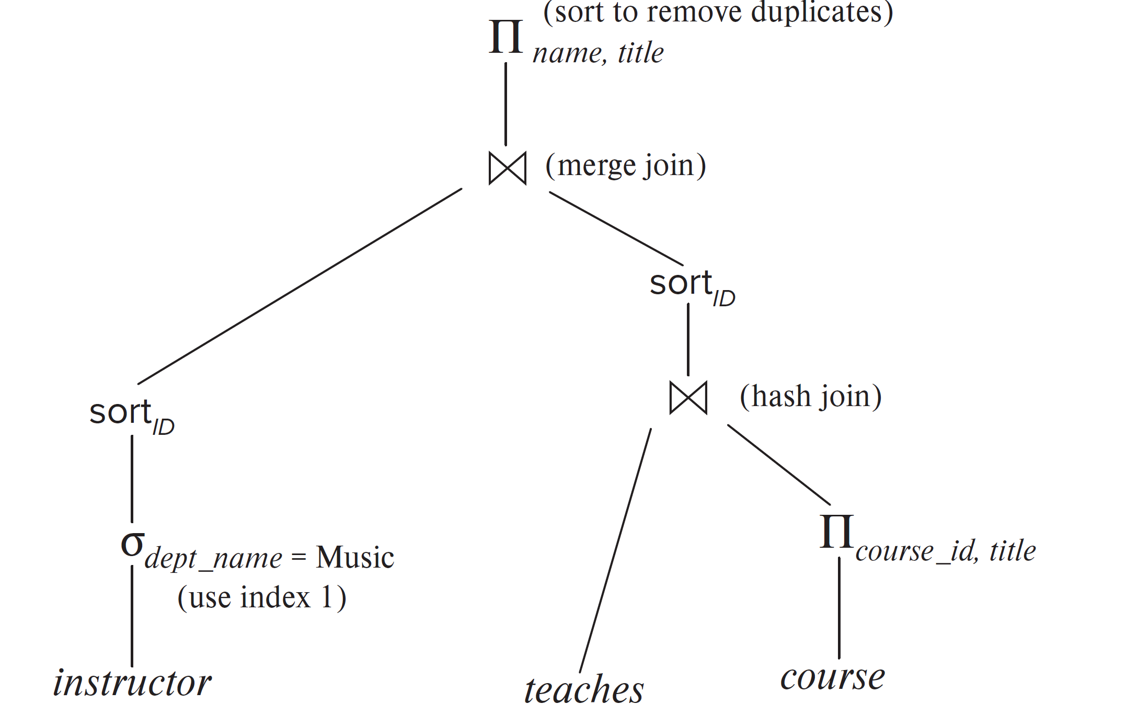
执行计划
An evaluation plan defines exactly what algorithm is used for each operation, and how the execution of the operations is coordinated.
pipeline
pipeline

Slide 10
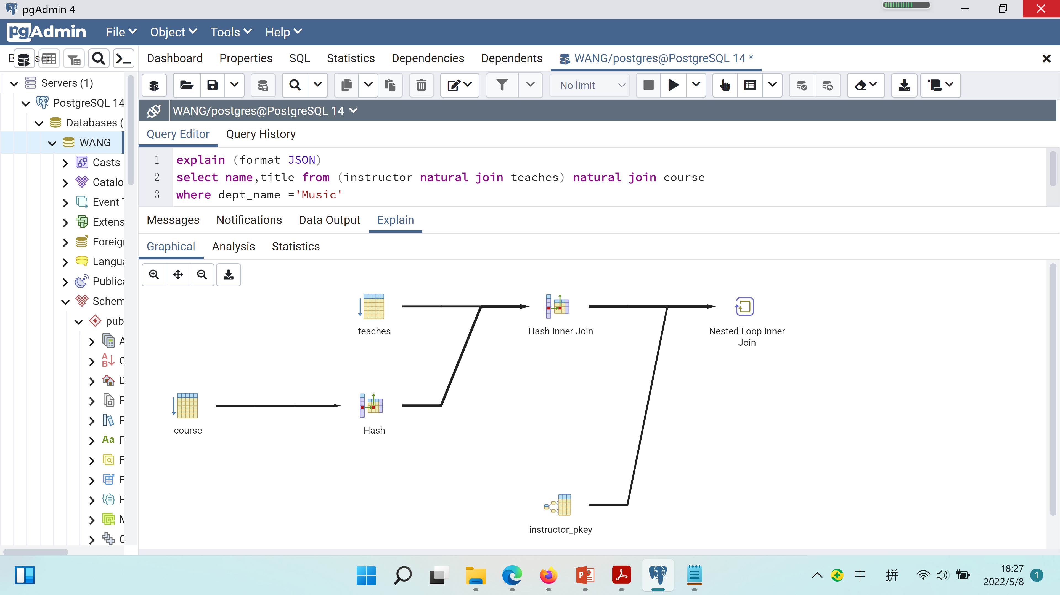
在PG中查看执行计划
explain (format JSON) select name,title from (instructor natural join teaches) natural join course where dept_name ='Music'

Slide 11
基于代价的查询优化
Cost difference between evaluation plans for a query can be enormous
  E.g. seconds vs. days in some cases
Steps in cost-based query optimization
  Generate logically equivalent expressions using equivalence rules
  Annotate resultant expressions to get alternative query plans
  Choose the cheapest plan based on estimated cost
Estimation of plan cost based on:
  关系统计信息：Statistical information about relations. Examples:
    number of tuples, number of distinct values for an attribute
  中间结果估计：Statistics estimation for intermediate results
    to compute cost of complex expressions
  算法代价：Cost formulae for algorithms, computed using statistics

Slide 12
Contents
Introduction
Transformation of Relational Expressions
Estimating Statistics of Expression Results
Choice of Evaluation Plans

Slide 13
表达式等价及其等价规则
Two relational algebra expressions are said to be equivalent(等价) if the two expressions generate the same set of tuples on every legal database instance
  Note: order of tuples is irrelevant
In SQL, inputs and outputs are multisets of tuples
  Two expressions in the multiset version of the relational algebra are said to be equivalent if the two expressions generate the same multiset of tuples on every legal database instance.
An equivalence rule says that expressions of two forms are equivalent
  Can replace expression of first form by second, or vice versa

Slide 14



等价规则1、2、3、4
1. Conjunctive selection operations can be deconstructed into a sequence of individual selections. 也称作选择的级联
2. Selection operations are commutative. 即选择交换律
3. Only the last in a sequence of projection operations is needed, the others can be omitted.也称作投影的级联
Selections can be combined with Cartesian products and theta joins.选择对笛卡尔积和条件连接的分配律
  σ_{θ}(E₁ X E₂) = E₁ _{θ} E₂
  σ_{θ1}(E₁ _{θ2} E₂) = E₁ _{θ1∧ θ2} E₂

Slide 15
等价规则5、6
Theta-join operations (and natural joins) are commutative.
E_{1 θ} E₂ = E₂ _{θ} E₁
6. (a) Natural join operations are associative:
(E₁ E₂) E₃ = E₁ (E₂ E₃)
(b) Theta joins are associative in the following manner:
(E_{1 θ1} E₂) _{θ2∧ θ3} E₃ = E_{1 θ1∧ θ3} (E₂ _{θ2} E₃)
where θ₂ involves attributes from only E₂ and E₃.
条件连接与自然连接的交换律
自然连接结合律

Slide 16
等价规则7
7. The selection operation distributes over the theta join operation under the following two conditions:
(a) When all the attributes in θ₀ involve only the attributes of one
of the expressions (E₁) being joined.
σ_{θ0}(E₁ _{θ} E₂) = (σ_{θ0}(E₁)) _{θ} E₂
(b) When θ ₁ involves only the attributes of E₁ and θ₂ involves
only the attributes of E₂.
σ_{θ1}∧_{θ2} (E₁ _{θ} E₂) = (σ_{θ1}(E₁)) _{θ} (σ_{θ2} (E₂))
选择下推

Slide 17

等价规则5、6a、7a的示例

Slide 18
等价规则8
8. The projection operation distributes over the theta join operation as follows:
(a) if θ involves only attributes from L₁ ∪ L₂:
(b) Consider a join E_{1 θ} E₂.
  Let L₁ and L₂ be sets of attributes from E₁ and E₂, respectively.
  Let L₃ be attributes of E₁ that are involved in join condition θ, but are not in L₁ ∪ L₂, and
  let L₄ be attributes of E₂ that are involved in join condition θ, but are not in L₁ ∪ L₂.
∏
(
E
E
)
=
(
∏
(
E
))
(
∏
(
E
))
L
1
∪
L
2
1
θ
2
L
1
1
θ
L
2
2
∏
(
E
E
)
=
∏
((
∏
(
E
))
(
∏
(
E
)))
L
1
∪
L
2
1
θ
2
L
1
∪
L
2
L
1
∪
L
3
1
θ
L
2
∪
L
4
2
--pushing projections down
投影下推
Notes:
8(b) 意味着什么？

Slide 19
等价规则9、10、11、12
The set operations union and intersection are commutative 交换律
E₁ ∪ E₂ = E₂ ∪ E₁
E₁ ∩ E₂ = E₂ ∩ E₁
  (set difference is not commutative).
Set union and intersection are associative.结合律
(E₁ ∪ E₂) ∪ E₃ = E₁ ∪ (E₂ ∪ E₃)
(E₁ ∩ E₂) ∩ E₃ = E₁ ∩ (E₂ ∩ E₃)
The selection operation distributes over ∪, ∩ and –. 分配律
σ_{θ} (E₁ – E₂) = σ_{θ} (E₁) – σ_{θ}(E₂)
and similarly for ∪ and ∩ in place of –
Also: σ_{θ} (E₁ – E₂) = σ_{θ}(E₁) – E₂
and similarly for ∩ in place of –, but not for ∪
12. The projection operation distributes over union 分配律
Π_{L}(E₁ ∪ E₂) = (Π_{L}(E₁)) ∪ (Π_{L}(E₂))

Slide 20
等价规则13、14、15、16
13. Selection distributes over aggregation as below
σ_{θ}(_{G}𝛾_{A}(E)) ≡ _{G}𝛾_{A}(σ_{θ}(E))
provided θ only involves attributes in G
14. a. Full outerjoin is commutative:
E₁ ⟗ E₂ ≡ E₂ ⟗ E₁
b. Left and right outerjoin are not commutative, but:
E₁ ⟕ E₂ ≡ E₂ ⟖ E₁
15. Selection distributes over left and right outerjoins as below, provided θ₁
only involves attributes of E₁
a. σ_{θ1} (E₁ ⟕_{θ} E₂) ≡ (σ_{θ1} (E₁)) ⟕_{θ} E₂
b. σ_{θ1} (E₂ ⟖_{θ} E₁) ≡ E₂ ⟖_{θ} (σ_{θ1} (E₁))
16. Outerjoins can be replaced by inner joins under some conditions
a. σ_{θ1} (E₁ ⟕_{θ} E₂) ≡ σ_{θ1} (E₁ ⨝_{θ} E₂)
b. σ_{θ1} (E₂ ⟖_{θ} E₁) ≡ σ_{θ1} (E₁ ⨝_{θ} E₂)
provided θ₁ is null rejecting on E₂
Notes:
Theta1 是关系代数表达式E2 控制屏蔽的/抵制的条件表达式

Slide 21
讨论题
instructor(id, name, dept_name, salary),
teaches(id, course_id, sec_id, semester, year)
σ_{year=2017}(instructor ⟕ teaches) ≡ σ_{year=2017}(instructor ⨝ teaches) ？ why?
2. σ_{year=2017}(instructor ⟕ teaches) ≡ instructor ⟕σ_{year=2017}(teaches) ？Why?
3. Outer joins are not associative, provided r(A,B), s(B,C), t(A,C), giving an example such that:
(r ⟕s)⟕t ≢ r ⟕(s⟕t)
Hint: r and s are (1,1) , t is empty.

Slide 22
应用1：选择下推
Query: Find the names of all instructors in the Music department, along with the titles of the courses that they teach
  Π_{name, title}(σ_{dept_name= “Music”}
  (instructor (teaches Π_{course_id, title} (course))))
Transformation using rule 7a.
  Π_{name, title}((σ_{dept_name= “Music”}(instructor))
  (teaches Π_{course_id, title} (course)))
instructor(id, name, dept_name, salary)
teaches(id, course_id, sec_id, semester, year)
course(course_id, title, dept_name, credits)

Slide 23
应用2：多次转换
Query: Find the names of all instructors in the Music department who have taught a course in 2009, along with the titles of the courses that they taught
  Π_{name, title}(σ_{dept_name= “Music”∧year = 2009}
  (instructor (teaches Π_{course_id, title} (course))))
Transformation using join associatively (Rule 6a):
  Π_{name, title}(σ_{dept_name= “Music”∧year = 2009}
  ((instructor teaches) Π_{course_id, title} (course)))
Second form provides an opportunity to apply the “perform selections early” rule, resulting in the subexpression(rule 7b)
σ_{dept_name = “Music”} (instructor) σ _{year = 2009} (teaches)

Slide 24

多次转换的图示

Slide 25
应用3：投影下推
Consider: Π_{name, title}(σ_{dept_name= “Music”} (instructor teaches)
Π_{course_id, title} (course))
When we compute
σ_{dept_name = “Music”} (instructor teaches)
we obtain a relation whose schema is:
(ID, name, dept_name, salary, course_id, sec_id, semester, year)
Push projections using equivalence rules 8a and 8b; eliminate unneeded attributes from intermediate results to get:
Π_{name, title}(Π_{name, course_id} (
σ_{dept_name= “Music”} (instructor) teaches))
Π_{course_id, title} (course))))
Performing the projection as early as possible reduces the size of the relation to be joined.

Slide 26
应用4：连接的次序
For all relations r_{1,} r_{2,} and r₃,
(r₁ r₂) r₃ = r₁ (r₂ r₃ )
(Join Associativity)
If r₂ r₃ is quite large and r₁ r₂ is small, we choose
(r₁ r₂) r₃
so that we compute and store a smaller temporary relation.
--equivalence rule 6.a

Slide 27
案例分析
Consider the expression
Π_{name, title}(σ_{dept_name= “Music”} (instructor) teaches
Π_{course_id, title} (course) )
Could compute teaches Π_{course_id, title} (course) first, and join result with
σ_{dept_name= “Music”} (instructor)
but the result of the first join is likely to be a large relation.
Only a small fraction of the university’s instructors are likely to be from the Music department
  it is better to compute
σ_{dept_name= “Music”} (instructor) teaches
first.

Slide 28
等价表达式的生成
Query optimizers use equivalence rules to systematically generate expressions equivalent to the given expression
Can generate all equivalent expressions as follows:
  Repeat
    apply all applicable equivalence rules on every subexpression of every equivalent expression found so far
    add newly generated expressions to the set of equivalent expressions
    Until no new equivalent expressions are generated above

Slide 29
Contents
Introduction
Transformation of Relational Expressions
Estimating Statistics of Expression Results
Choice of Evaluation Plans

Slide 30

主要统计量-Catalog Information
n_{r}: number of tuples in a relation r.
b_{r}: number of blocks containing tuples of r.
l_{r}: size of a tuple of r.
f_{r}: blocking factor of r — i.e., the number of tuples of r that fit into one block.
V(A, r): number of distinct values that appear in r for attribute A; same as the size of ∏_{A}(r).
If tuples of r are stored together physically in a file, then:
COMPUTING AND MAINTAINING STATICS in Page 593

Slide 31

直方图-对多集的刻画
关系代数的多值集合语义
(Chp.3)
multiset relations r₁ (A, B) and r₂ (C)
  r₁ = {(1, a) (2,a)} r₂ = {(2), (3), (3)}
Π_{B}(r₁) would be {(a), (a)}
Equi-width histograms
Equi-depth histograms
等宽直方图
等深直方图
40
30
20
10
1
2
3
4
5
6
7
Histogram on attribute age of relation person

Slide 32
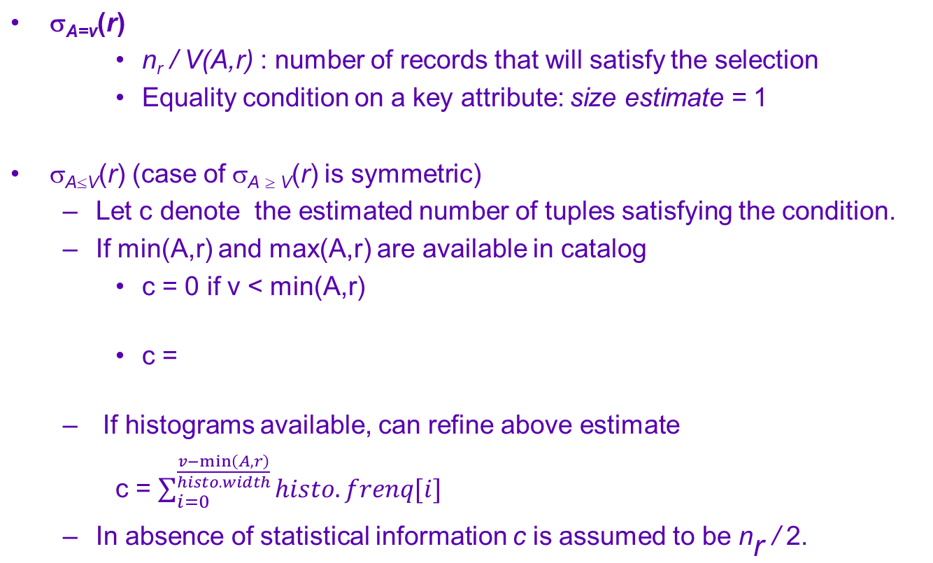
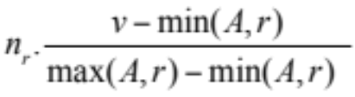
选择规模估计
Notes:
注意：估计的单位是元组个数

Slide 33


复杂选择规模估计
The selectivity(选择率） of a condition θ_{i} is the probability that a tuple in the relation r satisfies θ_{i} .
  If s_{i} is the number of satisfying tuples in r, the selectivity of θ_{i} is given by s_{i} /n_{r}.
Conjunction: σ_{θ1∧ θ2∧. . . ∧ θn} (r). Assuming indepdence, estimate of
tuples in the result is:
Disjunction:σ_{θ1∨} _{θ2 ∨. . . ∨} _{θn} (r). Estimated number of tuples:
Negation: σ_{¬θ}(r). Estimated number of tuples:
n_{r} – size(σ_{θ}(r))

Slide 34
连接操作
student(ID, name, dept_name, tot_cred)
takes(ID, course_id, sec_id,_semester, year, grade)
student takes
Catalog information for join examples:
n_{student} = 5,000.
f_{student} = 50, which implies that b_{student} =5000/50 = 100.
n_{takes} = 10000.
f_{takes} = 25, which implies that b_{takes} = 10000/25 = 400.
V(ID, takes) = 2500, which implies that on average, each student who has taken a course has taken 4 courses.
  Attribute ID in takes is a foreign key referencing student.
  V(ID, student) = 5000 (primary key!)
  V（Gender，student） = 2

Slide 35
连接操作规模估计
The Cartesian product r x s contains n_{r} .n_{s} tuples;
each tuple occupies l_{r} + l_{s} bytes.
If R ∩ S = ∅, then r s is the same as r x s.
If R ∩ S is a key for R, then a tuple of s will join with at most one tuple from r
  therefore, the number of tuples in r s is no greater than the number of tuples in s.
If R ∩ S in S is a foreign key referencing R, then the number of tuples in r s is exactly the same as the number of tuples in s.
  The case for R ∩ S being a foreign key in R referencing S is symmetric.
In the example query student takes, ID in takes is a foreign key referencing student
  hence, the result has exactly n_{takes} tuples, which is 10000

Slide 36


进一步的估计
If R ∩ S = {A} is not a key for R or S.
If we assume that every tuple t in R produces tuples in R S, the number of tuples in R S is estimated to be:
If the reverse is true, the estimate obtained will be:
The lower of these two estimates is probably the more accurate one.
Can improve on above if histograms are available
  Use formula similar to above, for each cell of histograms on the two relations
= n_{r} * (n_{s} / V(A,s))
= n_{s} * (n_{r} / V(A,r))
r
s
r(A)直方图
s(A)直方图
B | A
a | 1
b | 1
c | 2
d | 3
A | C
1 | 甲
1 | 乙
3 | 丙
2
2
1
1
n_{r s} = 2*2+1*0+1*1
1
2
3
1
2
3
Notes:
*假设

Slide 37
连接操作估计的例子
Compute the size estimates for student takes without using information about foreign keys:
  V(ID, takes) = 2500, and
  V(ID, student) = 5000
  The two estimates are 5000 * 10000/2500 = 20,000 and 5000 * 10000/5000 = 10000
  We choose the lower estimate, which in this case, is the same as our earlier computation using foreign keys.

Slide 38
投影、聚合与集合操作规模估计
Projection: estimated size of ∏_{A}(r) = V(A,r)
Aggregation : estimated size of _{A}g_{F}(r) = V(A,r)
Set operations
  For unions/intersections of selections on the same relation: rewrite and use size estimate for selections
    E.g. σ_{θ1} (r) ∪ σ_{θ2} (r) can be rewritten as σ_{θ1 ˅ θ2} (r)
  For operations on different relations:
    estimated size of r ∪ s = size of r + size of s.
    estimated size of r ∩ s = minimum size of r and size of s.
    estimated size of r – s = r.
    All the three estimates may be quite inaccurate, but provide upper bounds on the sizes.

Slide 39
外连接规模估计
Outer join:
  Estimated size of r s = size of r s + size of r
    Case of right outer join is symmetric
  Estimated size of r s = size of r s + size of r + size of s

Slide 40
选择操作结果取值规模估计
Selections: σ_{θ} (r)
If θ forces A to take a specified value: V(A,σ_{θ} (r)) = 1.
    e.g., A = 3
If θ forces A to take on one of a specified set of values:
V(A,σ_{θ} (r)) = number of specified values.
    (e.g., (A = 1 V A = 3 V A = 4 )),
If the selection condition θ is of the form A op r
estimated V(A,σ_{θ} (r)) = V(A.r) * s
    where s is the selectivity of the selection.
In all the other cases: use approximate estimate of
min(V(A,r), n_{σθ (r)} )
  More accurate estimate can be got using probability theory, but this one works fine generally

Slide 41
连接操作结果取值规模估计
Joins: r s
If all attributes in A are from r
estimated V(A, r s) = min (V(A,r), n _{r s})
If A contains attributes A1 from r and A2 from s, then estimated
V(A,r s) =
min(V(A1,r)*V(A2 – A1,s), V(A1 – A2,r)*V(A2,s), n_{r s})
  More accurate estimate can be got using probability theory, but this one works fine generally

Slide 42
投影与聚合操作结果规模估计
Estimation of distinct values are straightforward for projections.
  They are the same in ∏_{A (r)} as in r.
The same holds for grouping attributes of aggregation.
For aggregated values
  For min(A) and max(A), the number of distinct values can be estimated as min(V(A,r), V(G,r)) where G denotes grouping attributes
  For other aggregates, sum(), avg(), count(), etc., assume all values are distinct, and use V(G,r)
_{branch-name} g _{min(balance)} (account)
_{branch-name} g _{sum(balance)} (account)

Slide 43
Contents
Introduction
Transformation of Relational Expressions
Estimating Statistics of Expression Results
Choice of Evaluation Plans

Slide 44
代价估计
Cost of each operator computed as described in Chapter 15
  Need statistics of input relations
    E.g. number of tuples, sizes of tuples
Inputs of the operators can be results of sub-expressions
  Need to estimate statistics of expression results
  To do so, we require additional statistics
    E.g. number of distinct values for an attribute

Slide 45
查询优化器
Must consider the interaction of evaluation techniques when choosing evaluation plans
  choosing the cheapest algorithm for each operation independently may not yield best overall algorithm. E.g.
    merge-join may be costlier than hash-join, but may provide a sorted output which reduces the cost for an outer level aggregation
    nested-loop join may provide opportunity for pipelining
Query optimizers incorporate elements of the following two broad approaches:
  1. Search all the plans and choose the best plan in a cost-based fashion.
  2. Uses heuristics to choose a plan.

Slide 46
1）基于代价的连接顺序优化
Consider finding the best join-order for r₁ r₂ . . . r_{n}.
There are (2(n – 1))!/(n – 1)! different join orders for above expression. With n = 7, the number is 665280, with n = 10, the number is greater than 17.6 billion!
No need to generate all the join orders. Using dynamic programming, the least-cost join order for any subset of
{r₁, r₂, . . . r_{n}} is computed only once and stored for future use.

Slide 47
动态规划算法
To find best join tree for a set of n relations:
  To find best plan for a set S of n relations, consider all possible plans of the form: S₁ (S – S₁) where S₁ is any non-empty subset of S.
  Recursively compute costs for joining subsets of S to find the cost of each plan. Choose the cheapest of the 2^{n} – 2 alternatives.
  Base case for recursion: single relation access plan
    Apply all selections on R_{i} using best choice of indices on R_{i}
  When plan for any subset is computed, store it and reuse it when it is required again, instead of recomputing it
    Dynamic programming

Slide 48
连接顺序优化算法*
procedure findbestplan(S)
if (bestplan[S].cost ≠ ∞)
return bestplan[S]
// else bestplan[S] has not been computed earlier, compute it now
if (S contains only 1 relation)
set bestplan[S].plan and bestplan[S].cost based on the best way
of accessing S /* Using selections on S and indices on S */
else for each non-empty subset S1 of S such that S1 ≠ S
P1= findbestplan(S1)
P2= findbestplan(S - S1)
A = best algorithm for joining results of P1 and P2
cost = P1.cost + P2.cost + cost of A
if cost < bestplan[S].cost {
bestplan[S].cost = cost
bestplan[S].plan = “execute P1.plan; execute P2.plan;
join results of P1 and P2 using A”}
return bestplan[S]

Slide 49
值得关注的排序顺序
Consider the expression (r₁ r₂) r₃ (with common attribute A)
An interesting sort order is a particular sort order of tuples that could be useful for a later operation
  Using merge-join to compute r₁ r₂ may be costlier than hash join but generates result sorted on A
  Which in turn may make merge-join with r₃ cheaper, which may reduce cost of join with r₃ and minimizing overall cost
  Sort order may also be useful for order by and for grouping

Slide 50
对动态优化算法的改进
Not sufficient to find the best join order for each subset of the set of n given relations
  must find the best join order for each subset, for each interesting sort order
  Simple extension of earlier dynamic programming algorithms
  Usually, number of interesting orders is quite small and doesn’t affect time/space complexity significantly

Slide 51
2）基于等价变换规则的代价优化
Physical equivalence rules allow logical query plan to be converted to physical query plan specifying what algorithms are used for each operation.
Pioneered by the Volcano project and implemented in the SQL Server optimizer

Slide 52
2）基于等价变换规则的代价优化
Efficient optimizer based on equivalent rules depends on
  A space efficient representation of expressions which avoids making multiple copies of subexpressions
  Efficient techniques for detecting duplicate derivations of expressions
  A form of dynamic programming based on memoization, which stores the best plan for a subexpression the first time it is optimized, and reuses in on repeated optimization calls on same subexpression
  Cost-based pruning techniques that avoid generating all plans

Slide 53
3）启发式优化算法
Systems may use heuristics to reduce the number of choices that must be made in a cost-based fashion.
Heuristic optimization transforms the query-tree by using a set of rules that typically (but not in all cases) improve execution performance:
  Perform selection early (reduces the number of tuples)
  Perform projection early (reduces the number of attributes)
  Perform most restrictive selection and join operations (i.e. with smallest result size) before other similar operations.

Slide 54

左深连接树
In left-deep join trees, the right-hand-side input for each join is a relation, not the result of an intermediate join.
Left-deep join orders are particularly convenient for pipelined evaluation,
since the right operand is a stored relation, and thus only one input to each join is pipelined.

Slide 55
查询优化的工程考虑
Some query optimizers integrate heuristic selection and the generation of alternative access plans.
  Optimizers often use simple heuristics for very cheap queries, and perform exhaustive enumeration for more expensive queries
  Optimization cost budget to stop optimization early (if cost of plan is less than cost of optimization)
  Plan caching to reuse previously computed plan if query is resubmitted，even with different constants in query

Slide 56
End of Chapter

